Slide 1
METABOLIC RESPONSE TO SURGERY
Third Stage Medical College
2023
University of Basrah
College of Medicine
Department of Surgery
Professor Dr. Jasim M salman

Slide 2
Objectives
The effects of trauma /Surgery on metabolism
Consequences of the metabolic response

Slide 3
The stress response to surgery is a pattern of physiological and pathophysiological changes that occur in response to the stimulus of surgery. The response consists of two main categories:
(i)neuroendocrine–metabolic response
(ii)inflammatory–immune response
Our subject is the metabolic part

Slide 4
THE RESPONSE DEPENDS ON
1-The extent of surgery or trauma,
2- Invasiveness of the operation,
3- Duration of surgery

Slide 5
BODY RESPONSE
The response is to maintain physiological homeostasis perioperatively

Slide 6
Neuroendocrine–metabolic response
Means two limbs of responses
Sympathetic Nervous System and the Endocrine

Slide 7
Neuroendocrine–metabolic response
Sympathetic nervous system response
Related to secretion of Adrenaline
is secreted directly from the adrenal medulla in response to hypothalamic activation by the sympathetic nervous system (SNS)

Slide 8
Effect of adrenaline
Circulating adrenaline facilitates the sympathetic response
and mobilizes carbohydrate and fat stores.
Glycogenolysis and lypolysis Lead to Hyperglyceamia
Heart rate and vascular smooth muscle tone are controlled by the SNS.
Tachycardia and Hypertension

Slide 9
Endocrine system response
The hypothalamus organizes the hormonal stress response
Either directly or indirectly
Corticotrophin-releasing hormone (CRH),
Which stimulates the anterior pituitary gland to secrete Adrenocorticotropic hormone (ACTH).
This acts on cells in the zona fasciculata of the adrenal cortex to promote glucocorticoid (cortisol) secretion.

Slide 10
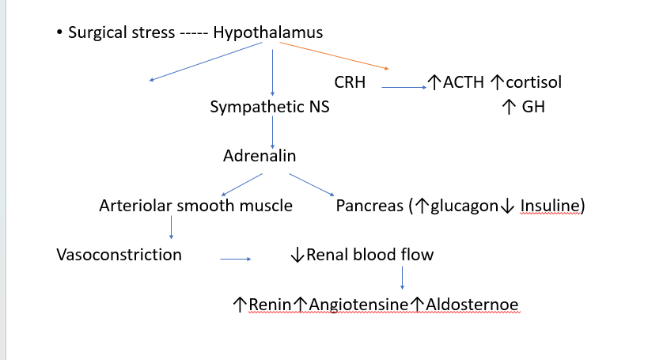

Slide 11
The major response will be
Glycogenolysis
Proteolysis
Lypolysis

Slide 12
Effect
Metabolic response
There will be hypermetabolism and hypercatabolism
This results in mobilisation of energy sources
*Liver glycogen stores are converted to glucose,
*Skeletal muscle proteolysis,
*Fat reserves lipolysis.
The body uses these substrates in tissue repair and as an energy source.

Slide 13
The other response
Sympathetis nervous system activation causes the release of adrenaline
Results in the stimulation of glucagon
Inhibition of insulin release. (effect on pancreatic α₂-adrenergic receptors)
With consequent decrease in insulin sensitivity in peripheral cells. These hormonal changes lead to hyperglycaemia and the release of fatty acids with relatively unopposed catabolism of muscle tissue.

Slide 14
Increased sympathetic activity
Increased sympathetic activity to the kidneys activates the renin–angiotensin–aldosterone system (RAAS).
Adrenaline-induced vasoconstriction of the renal afferent arterioles causes reduced renal blood flow, promoting the secretion of Renin.
Renin initiates conversion of angiotensin I to angiotensin II , which in turn stimulates the release of aldosterone from the adrenal cortex.

Slide 15
In addition, the posterior pituitary gland secretes ADH in response to both increased sympathetic activity and angiotensin II.

Slide 16
Together, the hormones aldosterone and ADH promote the retention of salt and water.
These changes play a role in the sustained maintenance of blood volume and increased vascular tone.

Slide 17
Fluid retention, oliguria, and accumulation of extracellular fluid are common in the acute postoperative period.
This is a protective feature to maintain arterial blood pressure in the setting of acute loss of plasma volume through, for example, haemorrhage. In addition, ADH and angiotensin have a direct vasopressor effect.

Slide 18
Modulation of stress response
Adequate Analgesia
Surgical time
The duration of surgery and the extent of intraoperative surgical manipulation and tissue injury are proportional to the associated stress response.
Regional anaesthesia

Slide 19
Control of response
Nutrition and fluids management
Enhanced recovery after surgery to improve postoperative outcomes and recovery times
A reduction in fasting time and preoperative carbohydrate loading have been shown to reduce the amount of fluid administered during surgery and reduce postoperative insulin resistance and associated catabolism.

Slide 20
Modulation of response
Maintenance of normothermia
Maintenance of normothermia is also beneficial in reducing the extent of the metabolic response to surgery

Slide 21
Monitoring
In order to follow the outcome we have to monitor for the following parameters
1- there should be a base line reading
2- vital signs (pulse rate, blood pressure, Spo2, End tidal CO2)
3- urine out put
4- blood sugar and serum electrolytes
5-heamatocrit ratio

Slide 22
Prolonged metabolic stress devoid of provision of adequate calories and protein may impair body functions with subsequent malnutrition
Elective surgical procedure considered minimum traumatic and the lowest nitrogen loss in urine,
Burn results in an increase in basal metabolic rate and urinary loss of nitrogen.

Slide 23
Questions
What is the role of endocrine glands in response to surgery

Slide 24
Question
Mention the effect of increased
1- Renine
2- Glucagon

Slide 25
Question
How do you attenuate the harmful response to surgery.

Slide 26
Question
What type of intravenous fluids are more appropriate for perioperative period

